Slide 2
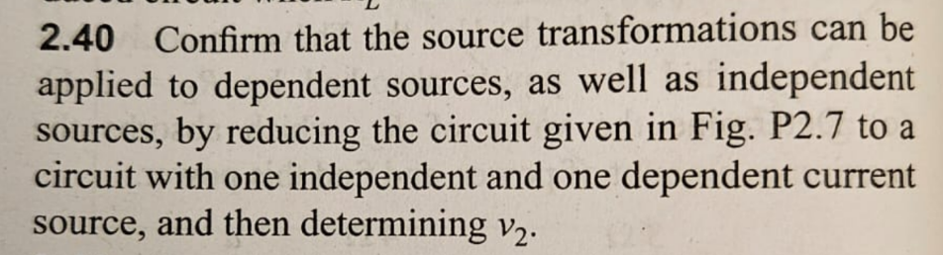
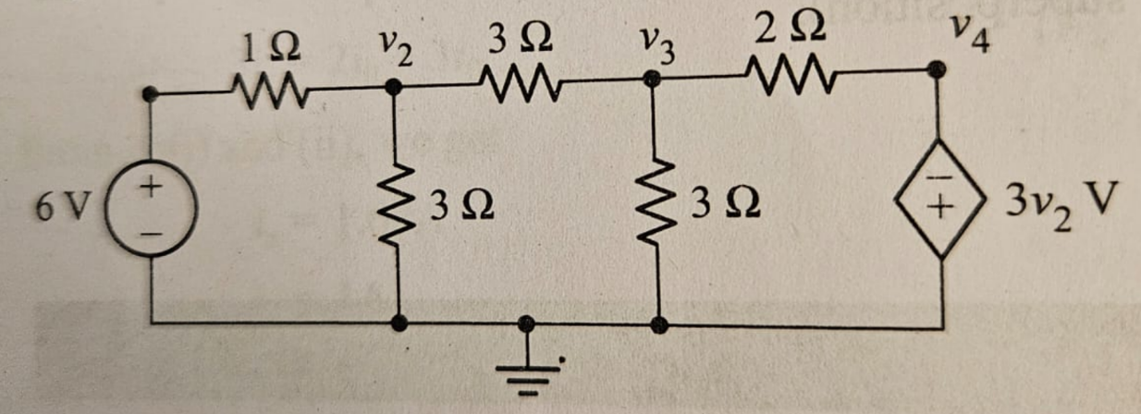
This one is conceptually very rich. It is not about heavy math; it is about thinking correctly with source transformations, especially with dependent sources
one independent current source
one dependent current source
and then determine the node voltage v₂​.
Big-Picture Strategy (Very Important)
Before touching equations, ask:
What is this problem really testing?
This problem is testing:
Whether you understand source transformation
Whether you know that dependent sources must NEVER be turned off
Whether you can reduce a circuit gradually, instead of writing nodal equations immediately
👉 The goal is not brute-force nodal analysis
👉 The goal is circuit reduction with insight
⚠ Critical Insight Before Proceeding
You are allowed to transform dependent sources
❌ But you are NOT allowed to suppress them
That means:
You can convert dependent voltage ↔ current sources
You cannot replace them with open/short circuits

Slide 3
1 Why source transformation works for dependent sources
Because it is based on terminal behavior, not internal implementation.
2 Why dependent sources are never turned off
They represent controlled behavior, not energy sources
3 Why nodal analysis becomes easier after transformation
Voltage sources disappear
Currents add algebraically
Control variables stay visible
4 How should approach such problems in exams
Transform independent sources first
Transform dependent sources carefully
Reduce to current-source form
Apply KCL
Solve slowly and cleanly

Slide 4
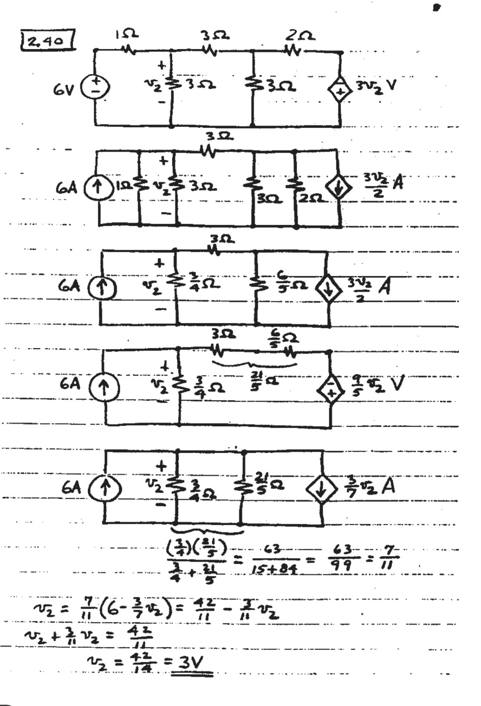

Slide 5
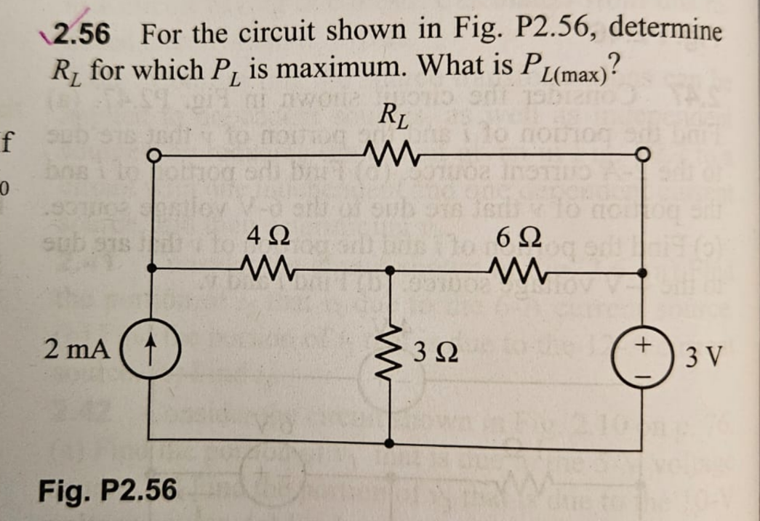
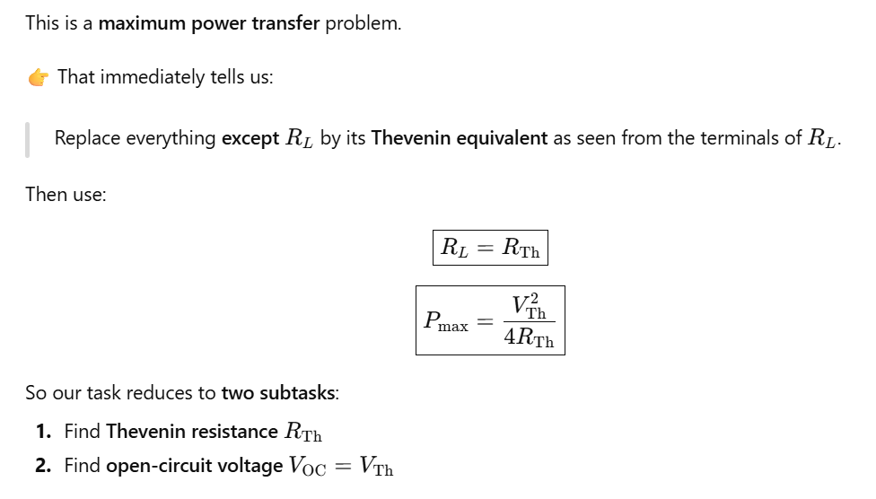
🔌 Step 2: Find Thevenin Resistance R_{Th}​
Rule reminder (very important for students):
To find R_{Th}​:
Turn off independent sources
  Voltage source → short
  Current source → open
Keep all resistors intact
Apply this to the circuit:
2 mA current source → open circuit
3 V voltage source → short circuit
Now look into terminals a–b.
Step 1: Remove the Load RL​
To find the Thevenin equivalent:
Remove RLR_LRL​ (open circuit)
Look into the network from terminals a–b

Slide 6
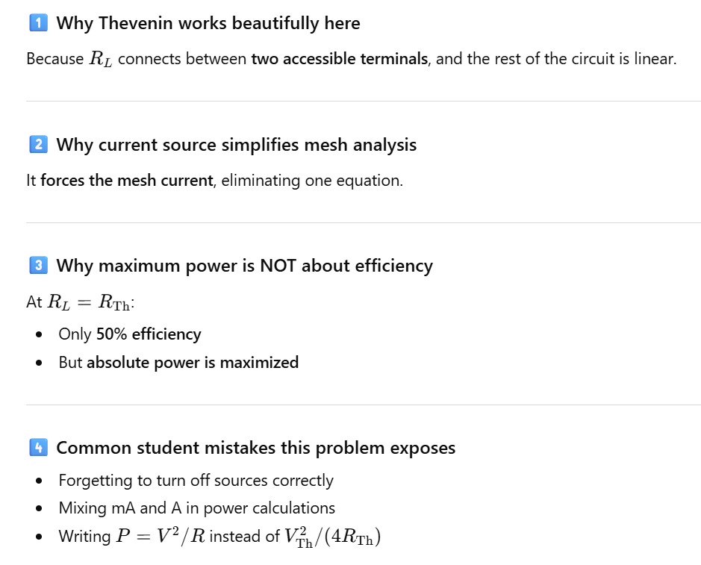

Slide 7
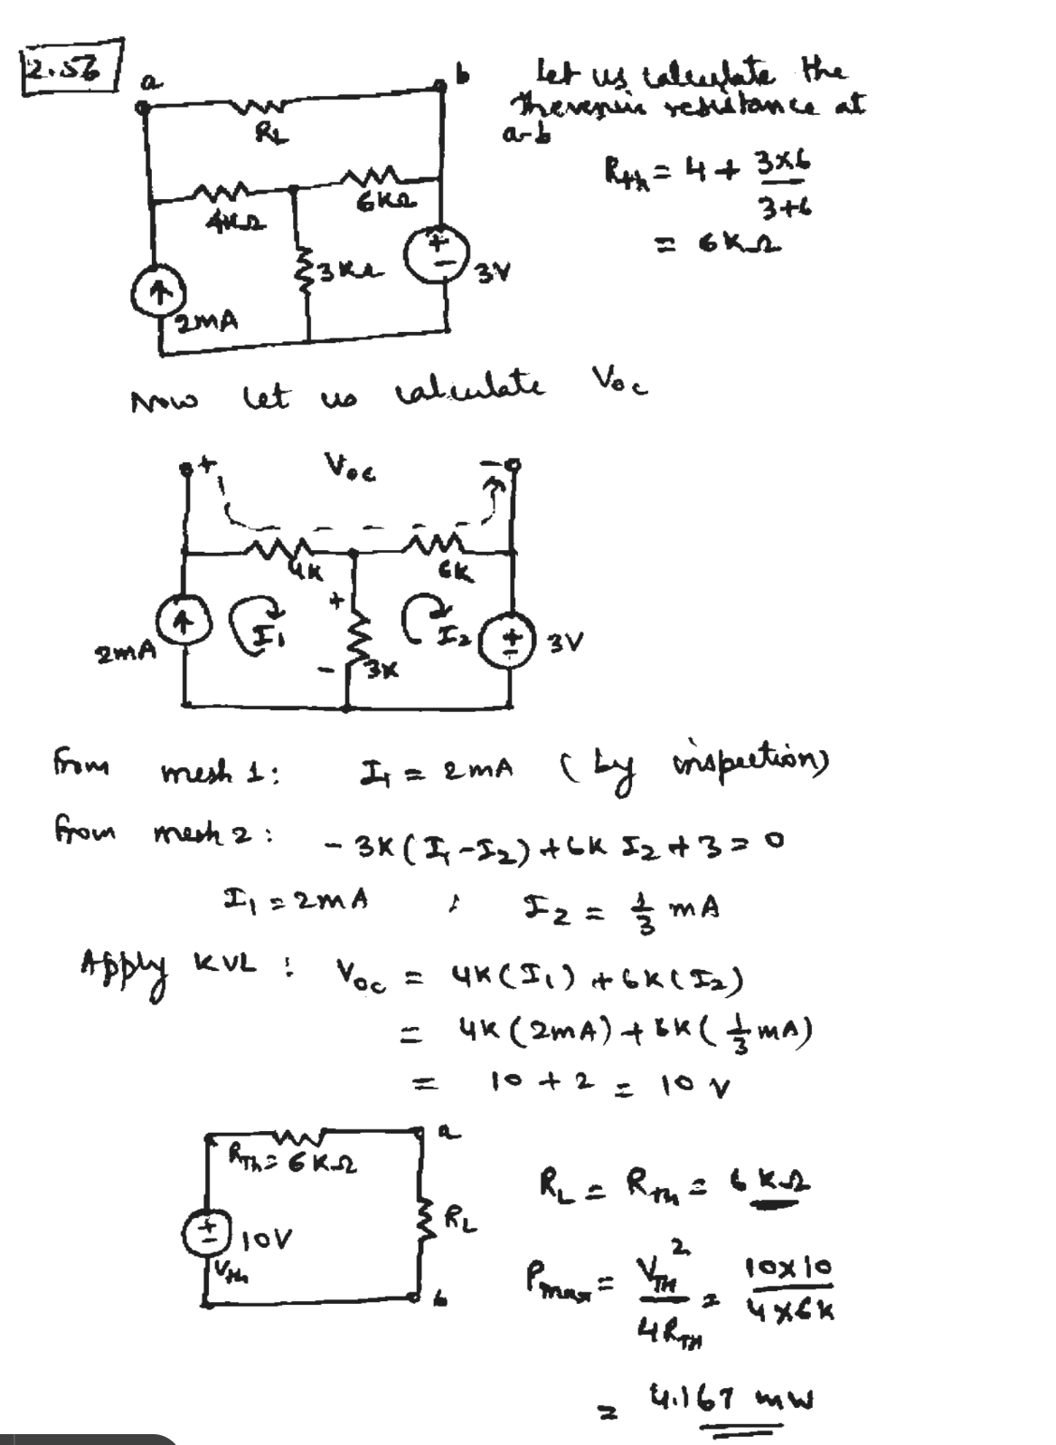

Slide 8
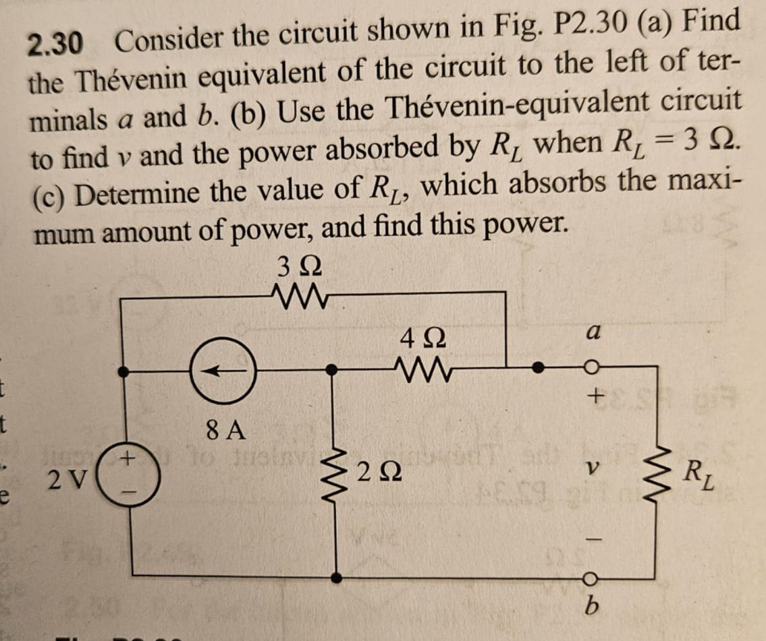
After this example, we should be able to:
Systematically find Thevenin voltage using nodal analysis
Correctly deactivate independent sources to find Thevenin resistance
Use the Thevenin model to compute load voltage and power
Apply the maximum power transfer theorem
Step 1: Remove the Load (Open Circuit)
To find the Thevenin equivalent:
Disconnect RL​
This makes the voltage at terminals a–b the open-circuit voltage Voc​
Important point:
Thevenin voltage is always the voltage seen at the output when nothing is connected.
Step 2: Choose a Reference Node
Choose terminal b as ground
Define:
  v1​ → node between the current source, 2 Ω, and 4 Ω
  voc​ → voltage at terminal a
Please Note :
Clear node labeling avoids sign mistakes later.
Deactivate Independent Sources
To find Rth​:
Voltage source → short circuit
Current source → open circuit
Rule to memorize:
Voltage → short
Current → open

Slide 9
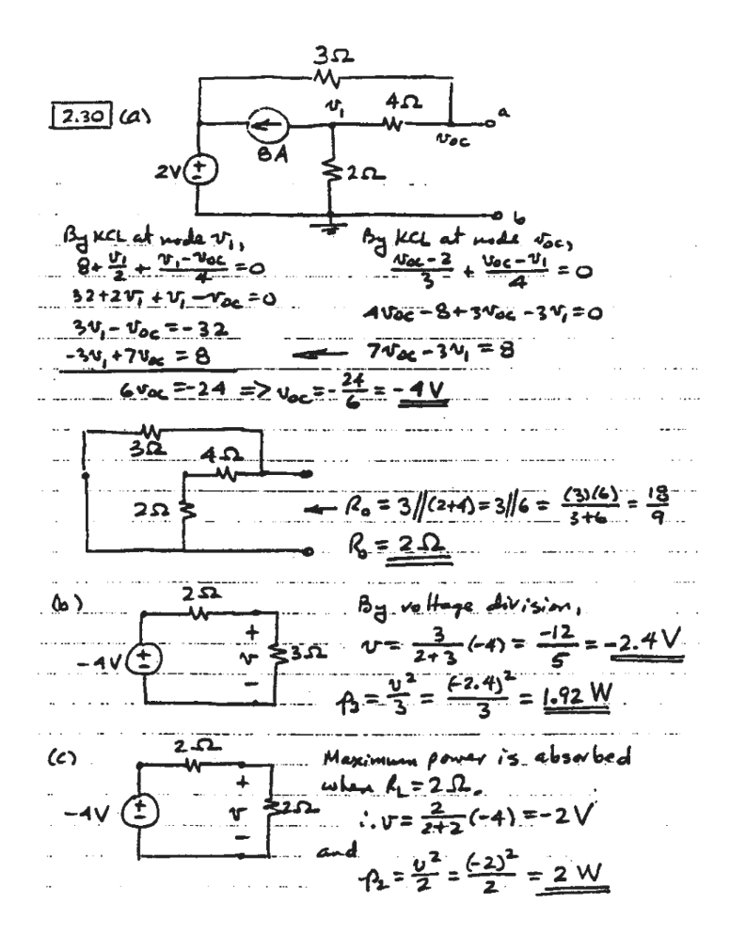

Slide 10
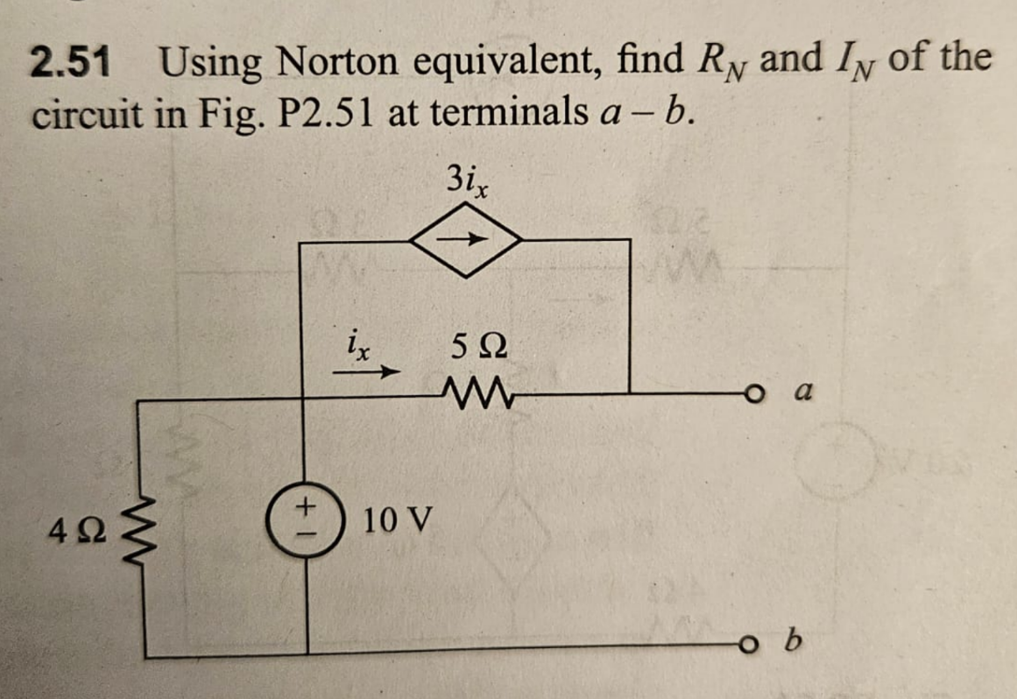
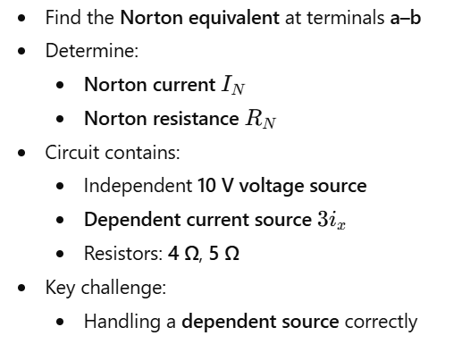
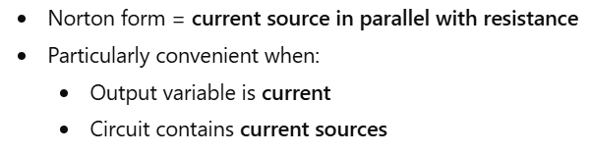
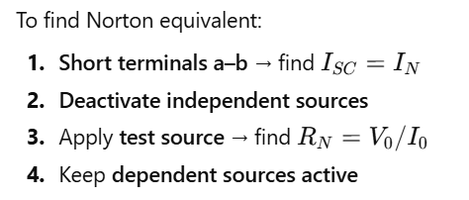

Slide 11
